Slide 1

Near-Earth Objects Analysis
IMPACT RISK ASSESSMENT & PLANETARY DEFENSE
Team ID: G-09
Krishna
Harshil
Aanya Mehrotra
Aditya Rana
Parv
Pihu Jaitly

Slide 2
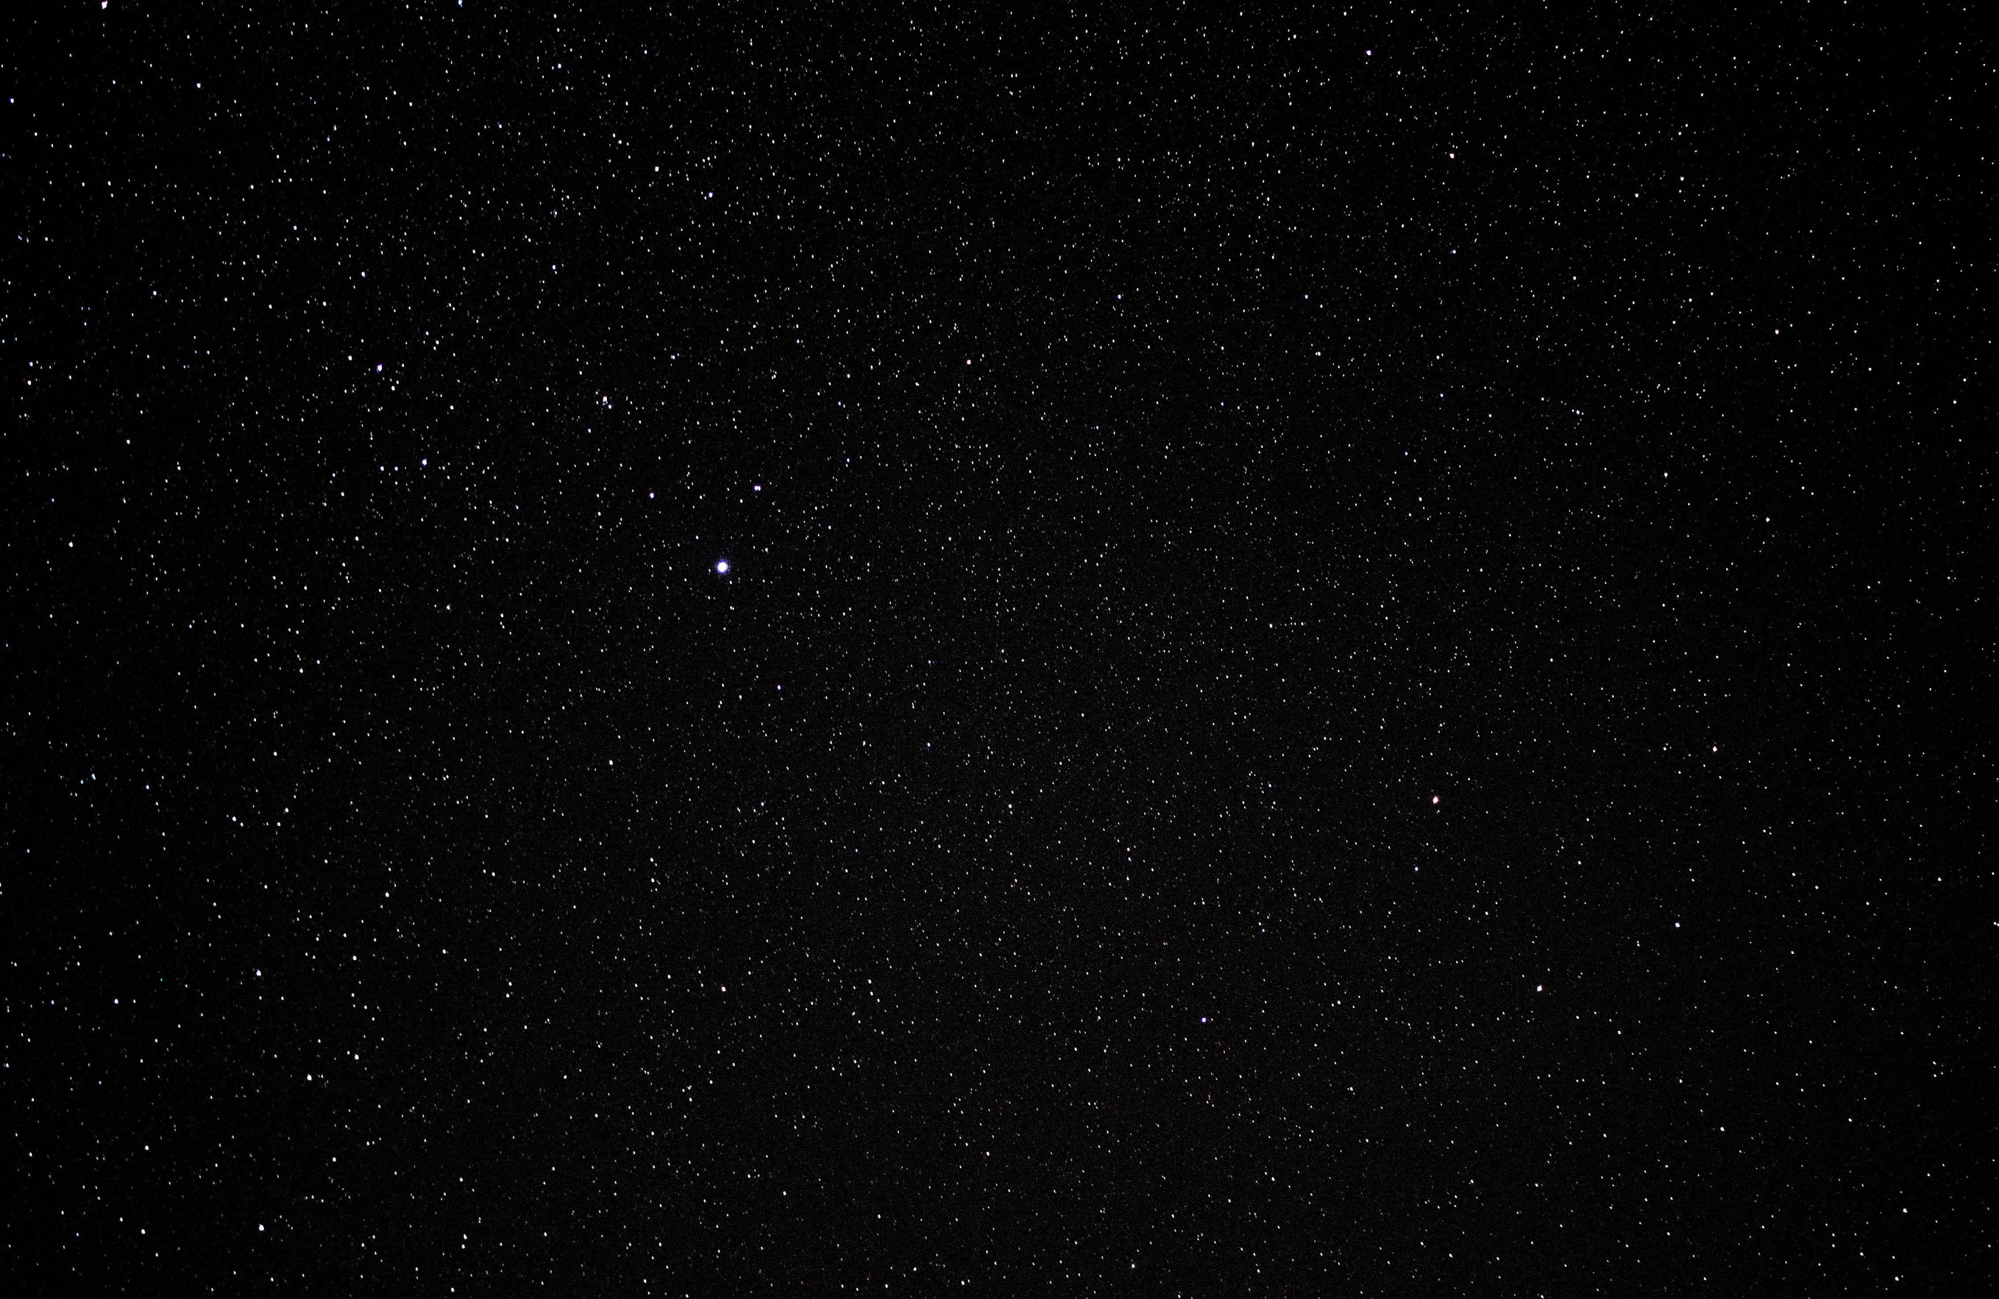



Planetary Context
Modern sky surveys capture hundreds of astronomical entries daily, identifying large numbers of objects. However, manual parsing of physical parameters introduces tracking bottlenecks for global planetary defense teams.
The Problem
Over 80% of targeted tracking records lack precise physical albedo and direct diameter metrics. The core objective for our group is to clean, extract, and statistically prove the leading orbital indicators of high-risk trajectory profiles.

Slide 3
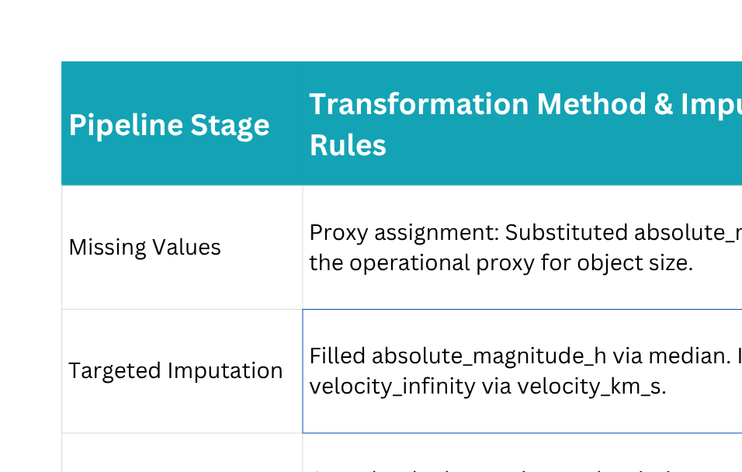
Data Engineering & Pipeline

Slide 4



KPI & Analytical Framework
Minimum Orbit Distance
Luminosity Proxy
Dynamic Velocity
MOID is measured directly to flag when a trajectory breaks orbital safety thresholds.
Absolute magnitude (H) acts as a reliable size proxy for physical impact models.
Correlating infinity velocity and direct space speed for consistent traversal metrics.

Slide 5
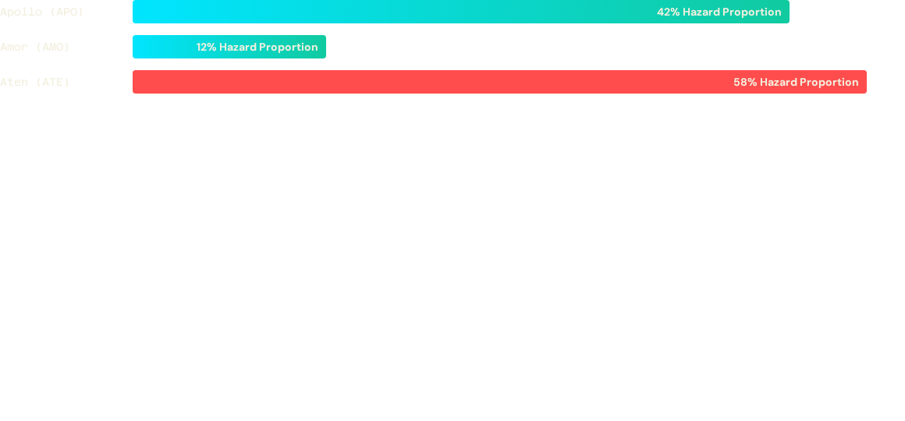
Data Engineering & Pipeline
Exploratory Focus: Aten group trajectories demonstrate the highest risk profile of potential impact hazards. This makes them a priority over Amor class orbits.

Slide 6
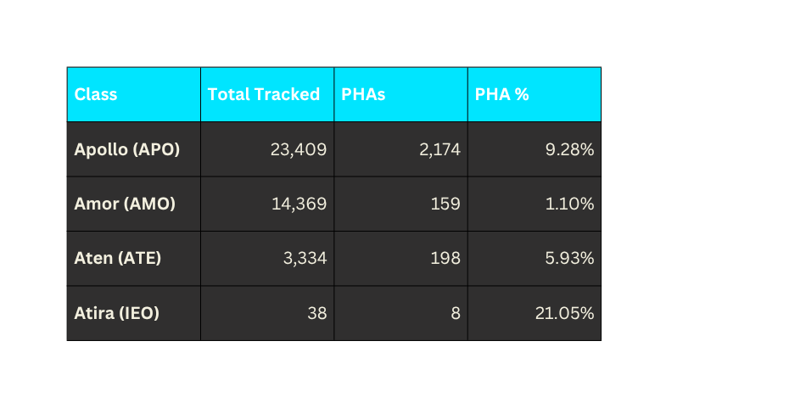
Advanced Analysis: Statistical Inference
Top Findings from EDA
Orbit Class Breakdown
Derived from the 03_eda.ipynb analysis workbook:
The 94% Rule: Filtering out objects with a MOID > 0.05 AU instantly removes 93.83% of the catalog as low risk.
Class Variance: The Aten group demonstrates the highest relative risk, with 5.93% of tracked objects flagged as potentially hazardous.
Extreme Skewness: The $H$ magnitude parameter has a strong right skew, highlighting that the catalog is heavily populated by small objects.

Slide 7
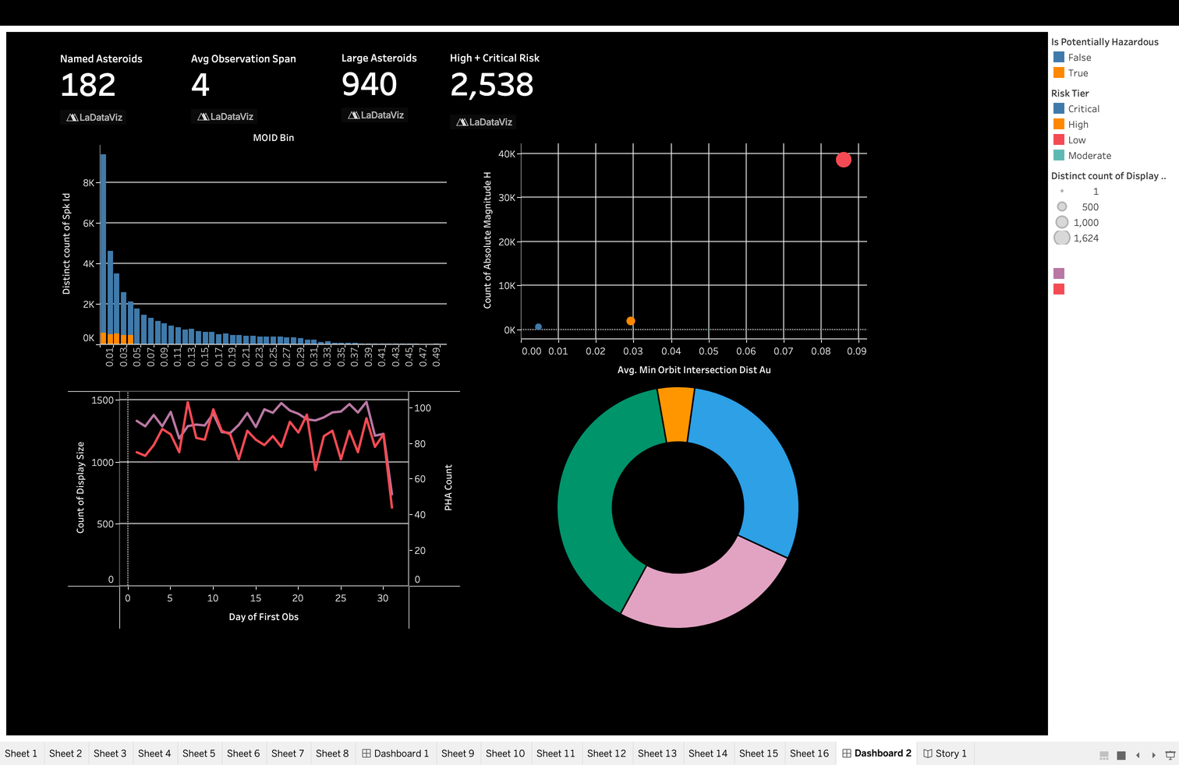
Tableau Walkthrough
4-Dashboard Integrated Design
Our interactive dashboard provides analytical views for both strategic and operational tracking:
NEA Executive Overview: High-level summaries of hazard counts and orbital class trends for quick scanning.
Orbital Mechanics Deep Dive: Drill-down scatter plots comparing orbital eccentricity and the semi-major axis.
Historical & Future Forecasting: Tracks past and future flyby trends based on distance and speed.

Slide 8
Actionable Recommendations
Top Findings from EDA
Recommendation 1
Insight: 93.83% of objects have a MOID > 0.05 AU.
Action: Set up early filtering thresholds at 0.05 AU to immediately exclude low-risk trajectory data and reduce analytical overhead.
Recommendation 3
Insight: The Aten group demonstrates the highest relative class hazard proportion.
Action: Direct observation resources to prioritize the Aten group over Amor and other lower-risk classes.
Recommendation 2
Insight: 80% of small records lack albedo metrics.
Action: Use median magnitude calculations as the standard size proxy to prevent measurement delays.

Slide 9
Modeled Project Impact
93.8%
Filtered Low-Risk Entries
Hours
Instead of Weeks in Alert Processing
By filtering out objects with a MOID above 0.05 AU, exactly **38,611 out of 41,150** records can be safely classified as low risk. This allows tracking assets to focus on the 6.17% of higher-risk objects, speeding up emergency alert response times.

Slide 10
Limitations & Future Scope
Constraints & Data Gaps
The current analysis relies on a static snapshot in time and lacks real-time orbital telemetry updates.
In addition, missing albedo values limit the precision of true physical diameter estimates, requiring a continued reliance on $H$ magnitude as a proxy.
Future Roadmap
Develop high-performance classification algorithms (such as Random Forests) to automate hazard detection.
We also aim to use machine learning imputation models to estimate missing albedo and diameter metrics, moving beyond standard median substitutions.

Slide 11
Thank You

